Slide 1
Dew Point

Slide 2
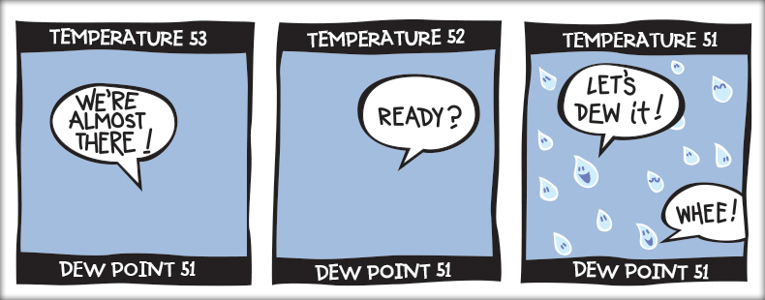
What is Dew Point?
Dew point is the temperature at which the air needs to be cooled to achieve saturation.
At the dew point, relative humidity is 100%.

Slide 3
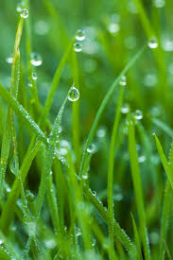
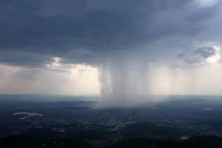
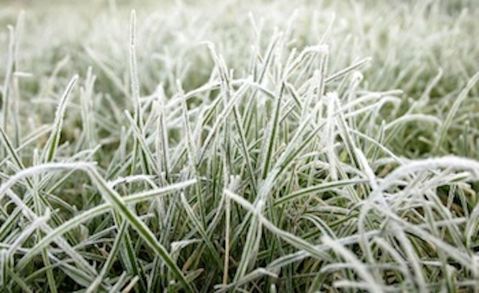
Dewpoint & Temperature
The dew point can never exceed the temperature of the air. If the temperature drops or water vapor is added to the air, condensation must occur.
This condensation can appear as clouds or dew, or if the dew point is below freezing, snow or frost.

Slide 4
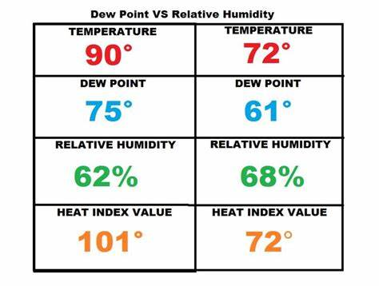
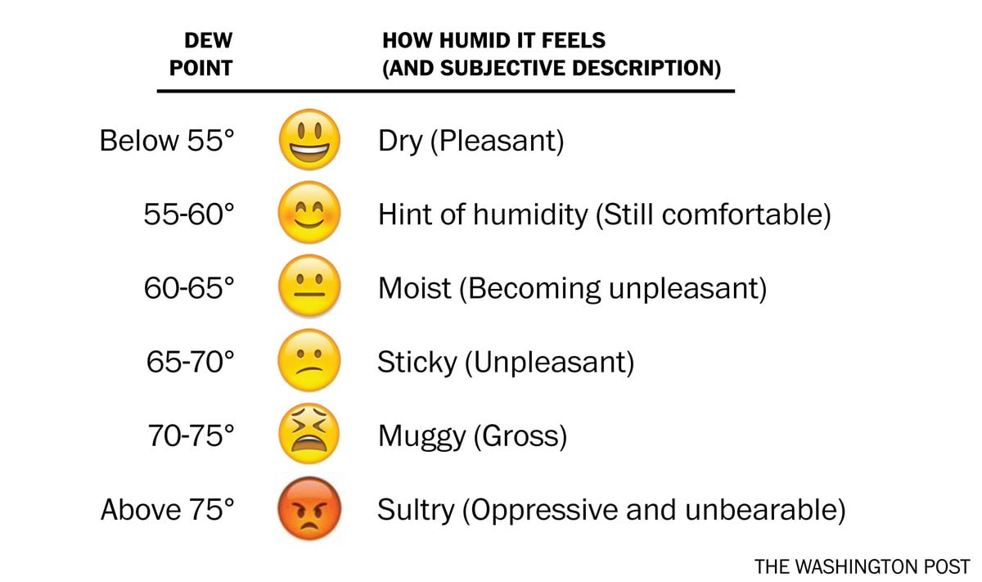
How to Use Dew Point
Meteorologist use dew point to estimate how much water vapor (humidity) is in the air. A higher dew point means more moisture and a lower dew point means less moisture.
On cooler (warmer) days, we need less (more) moisture in the air for it to feel humid.

Slide 5
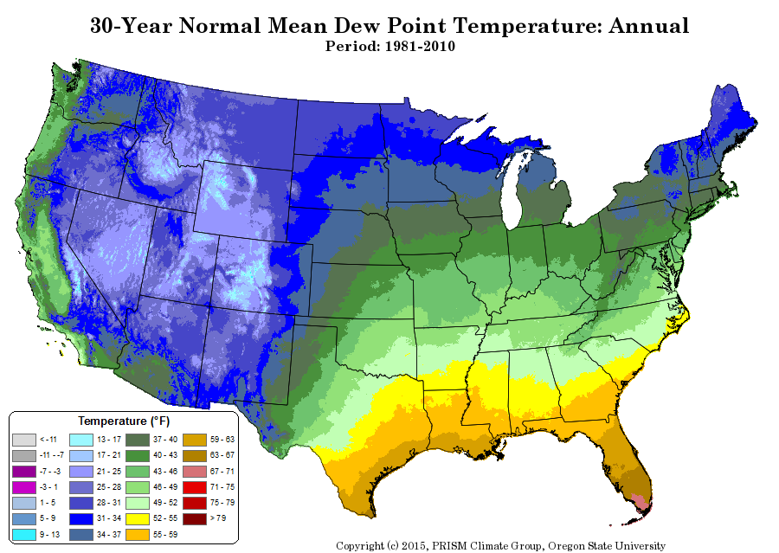
How to Use Dew Point
Since dew point is an absolute measure (only depends on humidity), values can be compared at different points.
What areas have the most moisture? The least?
What is causing this pattern?

